Slide 1
TREES IN DATA STRUCTURE
Tree and its basic terminologies Manahil Nadeem
Binary tree and Binary search tree Arooj Naz
Tree Traversal (In-order traversal) Esha Rehman
Pre-order and Post-order traversal Afifa Khalid
Insertion and Deletion in BST Aqsa Asghar
Searching in BST Afsah Ahmad

Slide 2
Tree and its basic terminologies
Manahil Nadeem
SP22-BCS-032

Slide 3
TREE
Tree has:
Parent Node
Child Node
Root Node
Leaf Node or External Node
Sibling
Level of a node
Internal node
Subtree
Depth of tree
Height of tree
Edge
A tree data structure is a hierarchical structure that is used to represent and organize data in a way that is easy to navigate and search.
It is a collection of nodes that are connected by edges and has a hierarchical relationship between the nodes.

Slide 4
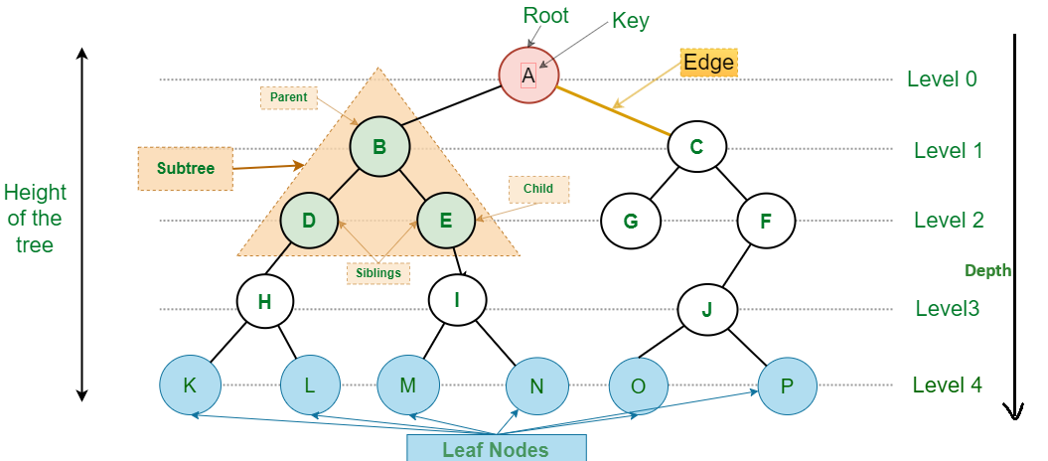

Slide 5
Applications of Trees
Database Indexing
Compiler Design
Artificial Intelligence
File Systems

Slide 6
Binary tree and Binary search tree
Arooj Naz
SP22-BCS-013

Slide 7
Binary Tree
Binary tree is a special tree data structure in which each node can have at most 2 children.
Each node has either 0 child or 1 child or 2 children.

Slide 8
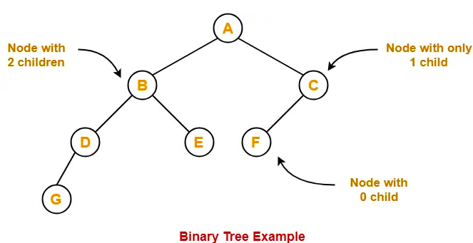
Example

Slide 9
Full / Strictly Binary Tree
A binary tree in which every node has either 0 or 2 children is called as a Full binary tree.
Full binary tree is also called as Strictly binary tree.

Slide 10
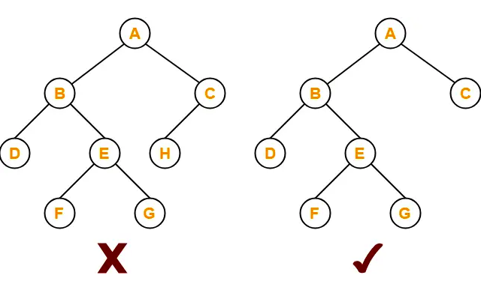
Example

Slide 11
Complete/Perfect Binary Tree
A complete binary tree has 2 properties:
Every internal node has exactly 2 children.
All the leaf nodes are at the same level.

Slide 12
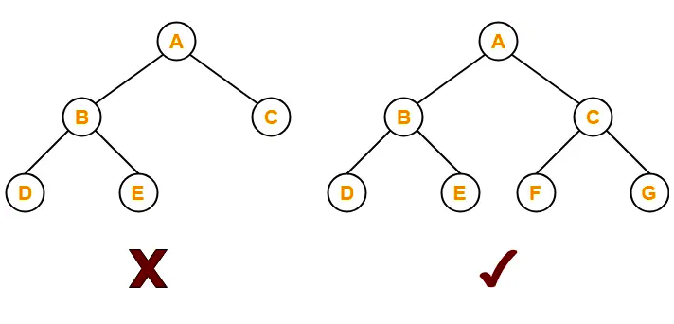
Example

Slide 13
Skewed Binary Tree
A skewed binary tree has 2 properties
All the nodes except one node have one and only one child.
The remaining node has no child.
OR
A skewed binary tree is a binary tree of n nodes such that its depth is (n-1).

Slide 14
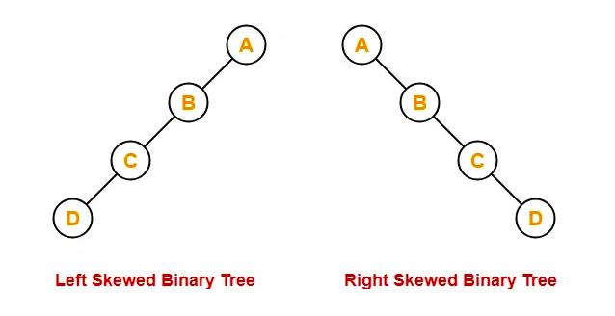
Example

Slide 15
Rooted Binary Tree
A rooted binary tree has 2 properties
It has a root node.
Each node has at most 2 children.

Slide 16
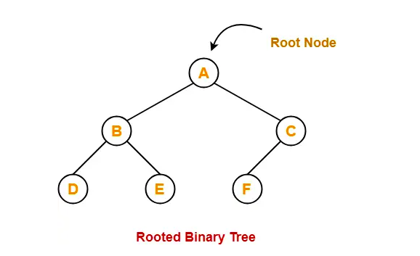
Example

Slide 17
Applications of Binary Tree
File Systems
Search Engines
Searching and Sorting Algorithms
Expression Trees

Slide 18
Binary Search tree
Binary Search Tree is a node-based binary tree data structure which has the following properties:
The left subtree contains only nodes with values lesser than root.
The right subtree contains only nodes with values greater than root.
The left and right subtree each must also be a binary search tree.

Slide 19
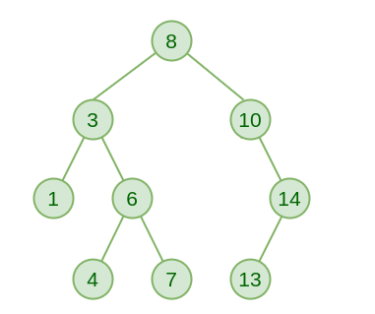
Example

Slide 20
Basic Operations
BST Traversals – Inorder, Preorder, Post Order
Insertion in Binary Search Tree
Deletion in Binary Search Tree
Searching in Binary Search Tree

Slide 21
Tree traversal
Esha Rehman
SP22-BCS-016

Slide 22
Introduction
Tree Traversal refers to the process of visiting each node in a tree data structure exactly once.
It forms the basis for operations on binary trees, expression trees, and other tree-like structures.
Applications include parsing expressions, searching, and sorting.

Slide 23
Techniques
Tree Traversal
Depth First Traversal
Breadth First Traversal
Inorder Traversal
Preorder Traversal
Postorder Traversal

Slide 24
Breadth First Traversal
A
prints all the nodes of a tree level by level.
also called as Level order traversal.
Applications
It is used to print the data in the same order as stored in the array representation of a complete binary tree.
B
C
D
E
F
G
Level order Traversal
A, B, C, D, E, F, G

Slide 25
Inorder Traversal
Left → Root → Right
Traverse the left subtree.
Visit the root.
Traverse the right subtree.
Application
Inorder traversal is used to get infix expression of an expression tree.
A
B
C
D
E
F
G
Inorder Traversal
D, B, E, A, F, C, G

Slide 26
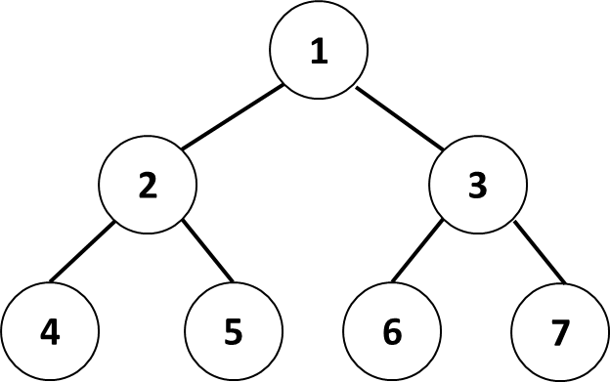
Inorder Traversal
struct node* createNode(int val) {
struct node* Node = new struct node;
Node->element = val;
Node->left = NULL;
Node->right = NULL;
return Node;
void traverseInorder(struct node* root) {
if (root == NULL)
return;
traverseInorder(root->left);
cout << " " << root->element << " ";
traverseInorder(root->right);
}
Inorder Traversal
4 2 5 1 6 3 7

Slide 27
Pre-order and Post-order traversal
Afifa Khalid
SP22-BCS-005

Slide 28
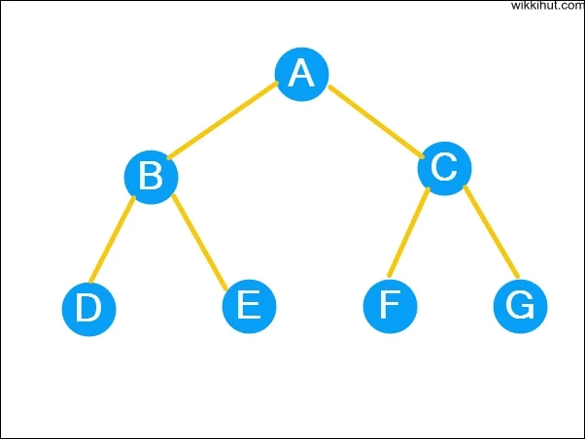
Pre-order traversal
Visit the root node.
Traverse the left subtree recursively.
Traverse the right subtree recursively.
Root node
Root → Left → Right
Left Subtree
Right Subtree

Slide 29
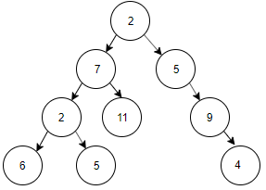
Example
Pre-order:
2, 7, 2, 6, 5, 11, 5, 9, 4

Slide 30
Pre-order Traversal
struct Node {
int data;
struct Node *left, *right;
};
Node* newNode(int data)
{
Node* temp = new Node;
temp->data = data;
temp->left = temp->right = NULL;
return temp;
}
void printPreorder(struct Node* node)
{
if (node == NULL)
return;
cout << node->data << " ";
printPreorder(node->left);
printPreorder(node->right);
}

Slide 31
Applications of Pre-order traversal
Prefix expression of an expression tree
Copy of a tree
BST construction
Decision tree traversal in machine learning

Slide 32
Post-order traversal
Traverse the left subtree recursively.
Traverse the right subtree recursively.
Visit the root node.
Root node
Root → Left → Right
Left Subtree
Right Subtree

Slide 33
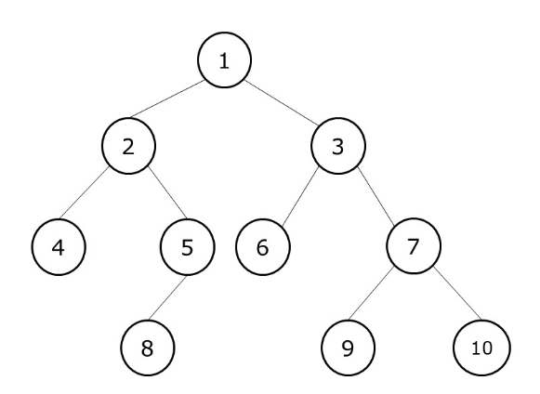
Example
Post-order:
4, 8, 5, 6, 9, 10, 7, 3, 1

Slide 34
Post-order Traversal
struct Node {
int data;
struct Node *left, *right;
};
Node* newNode(int data)
{
Node* temp = new Node;
temp->data = data;
temp->left = temp->right = NULL;
return temp;
}
void printPostorder(struct Node* node)
{
if (node == NULL)
return;
printPostorder(node->left);
printPostorder(node->right);
cout << node->data << " ";
}

Slide 35
Applications of Post-order traversal
Deleting nodes in BT
To get the postfix expression
Code generation in compilers
Mathematical evaluation and parsing

Slide 36
Insertion and deletion in BST
Aqsa Asghar
SP22-BCS-012

Slide 37
Insertion
Inserting an element in the Binary search tree
Rules
The insertion of a new key always takes place as the child of some leaf node.
For finding out the suitable leaf node,
Search the key to be inserted from the root node till some leaf node is reached.
Once a leaf node is reached, insert the key as child of that leaf node.

Slide 38
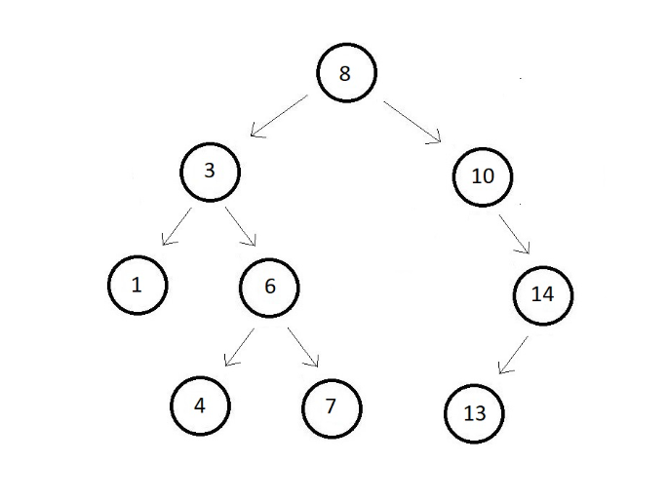
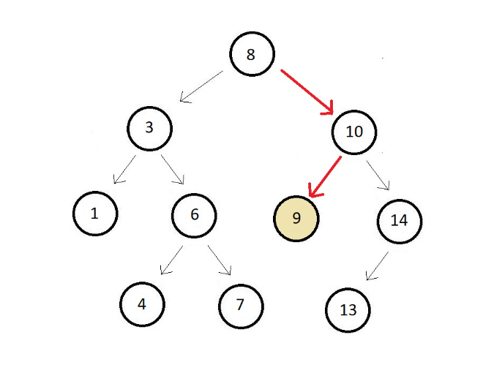
Example
Insert 9

Slide 39
Insertion Code
void insert(struct node *root, int key){
struct node *prev = NULL;
while(root!=NULL){
prev = root;
if(key==root->data){
return;
}
else if(key<root->data){
root = root->left;
}
else{
root = root->right;
}
}
struct node* new =
createNode(key);
if(key<prev->data){
prev->left = new;
}
else{
prev->right = new;
}}

Slide 40
Deletion
Deletion Operation is performed to delete a particular element from the Binary Search Tree.
Cases
Delete a Leaf Node or node with no child in BST
Delete a Node with Single Child in BST
Delete a Node with Both Children in BST

Slide 41
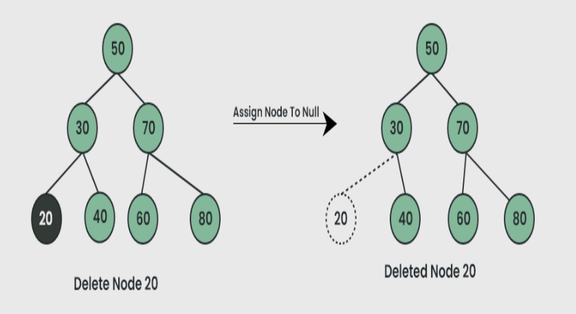
Delete a Leaf Node in BST
Case 1
Example

Slide 42
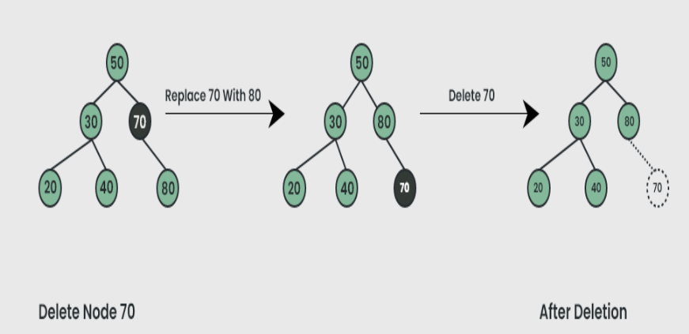
Case 2
Delete a Node with Single Child in BST
Example

Slide 43
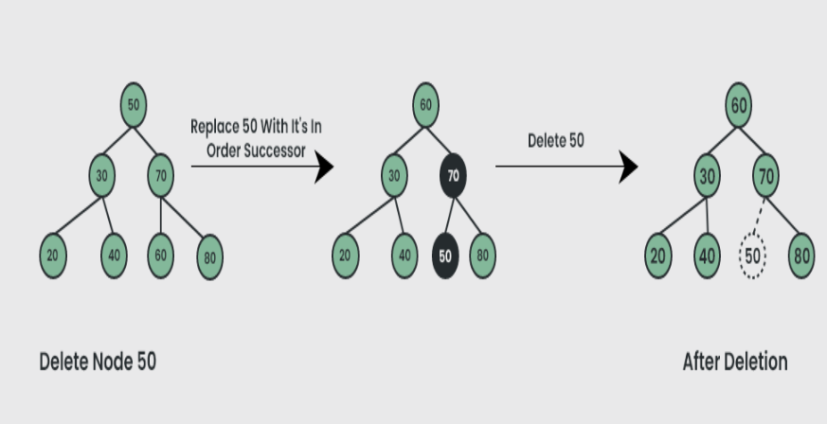
Case 3
Delete a Node with Both Children in BST
Example

Slide 44
Deletion Code
node * deleteNode(node * root, int key){
if(root == NULL) return root;
if(key < root->data){
root->left = deleteNode(root->left, key);
}
else if(key > root->data){
root->right = deleteNode(root->right, key);
}
else{
if(root->left == NULL){
node * temp = root->right;
delete(root);
return temp;
}
else if(root->right == NULL){
node * temp = root->left;
delete(root);
return temp;
}
node * temp = minValueNode(root->right);
root->data = temp->data;
root->right = deleteNode(root->right, temp->data);
}
return root;
}

Slide 45
Searching in BST
Afsah Ahmad
SP22-BCS-006

Slide 46
Searching In BST
Searching means finding or locating some specific element or node within a data structure.
Compare the element with the root of the tree.
If the key is matched then return the location of the node.
Otherwise check if the key is less than the element present on the root, if so then move to the left sub-tree.
If not, then move to the right sub-tree.
Repeat this procedure until a match is found.
If the element is not found then return NULL.

Slide 47
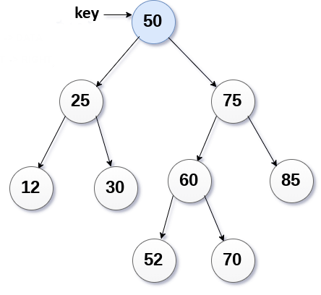
Searching Code
Node* SearchinBST(Node* root,int key)
{
If (root==NULL){
return NULL;
}
If(root->data==key){
return root;
{
If(root->data > key){
return SearchinBST(root->left,key);
{
return SearchinBST(root->right,key);
Root->data==key

Slide 48
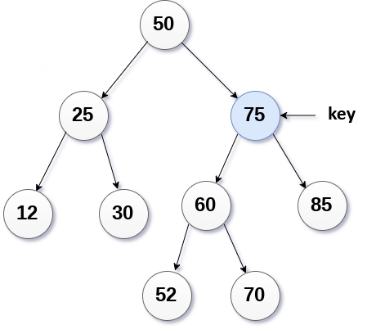
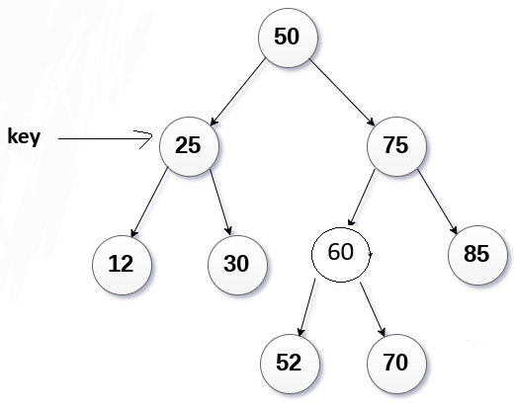
Root->data>key
Root->data<key

Slide 49
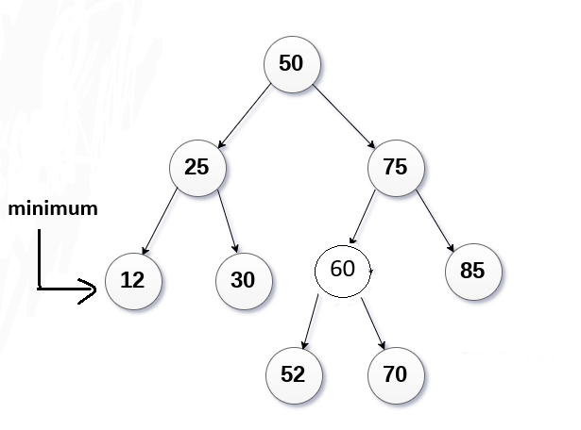
Finding a minimum value in BST
To find minimum value, traverse in left subtree of binary search tree.
int Searchmin(Node* root) {
if (root == NULL) {
cout << "Empty!" << endl;
return -1;
}
while (root->left != NULL) {
root = root->left;
}
return root->data;
}

Slide 50
Applications of Binary Search tree
BSTs are used for indexing.
Used to implement various search algorithms.
Used to compress data
Used to implement dictionaries.
Used for data caching.
Used in Priority queues.
Used in spell checkers.

Slide 51

Any Questions???

